Slide 1
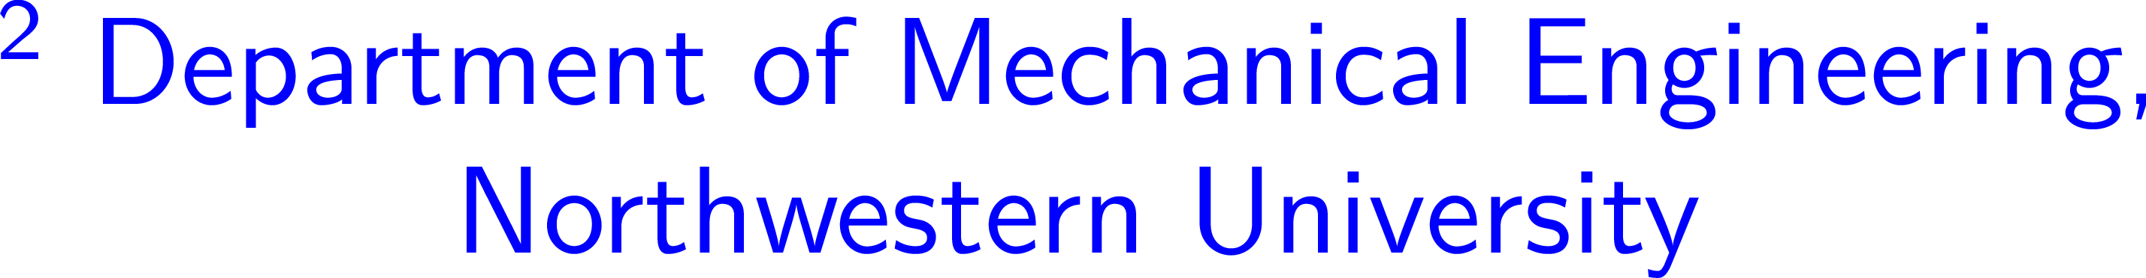



Notes:
I am going to talk about the homogenization result worked out in collaboration with Dr. VL for porous elastomers. (20 sec)

Slide 2
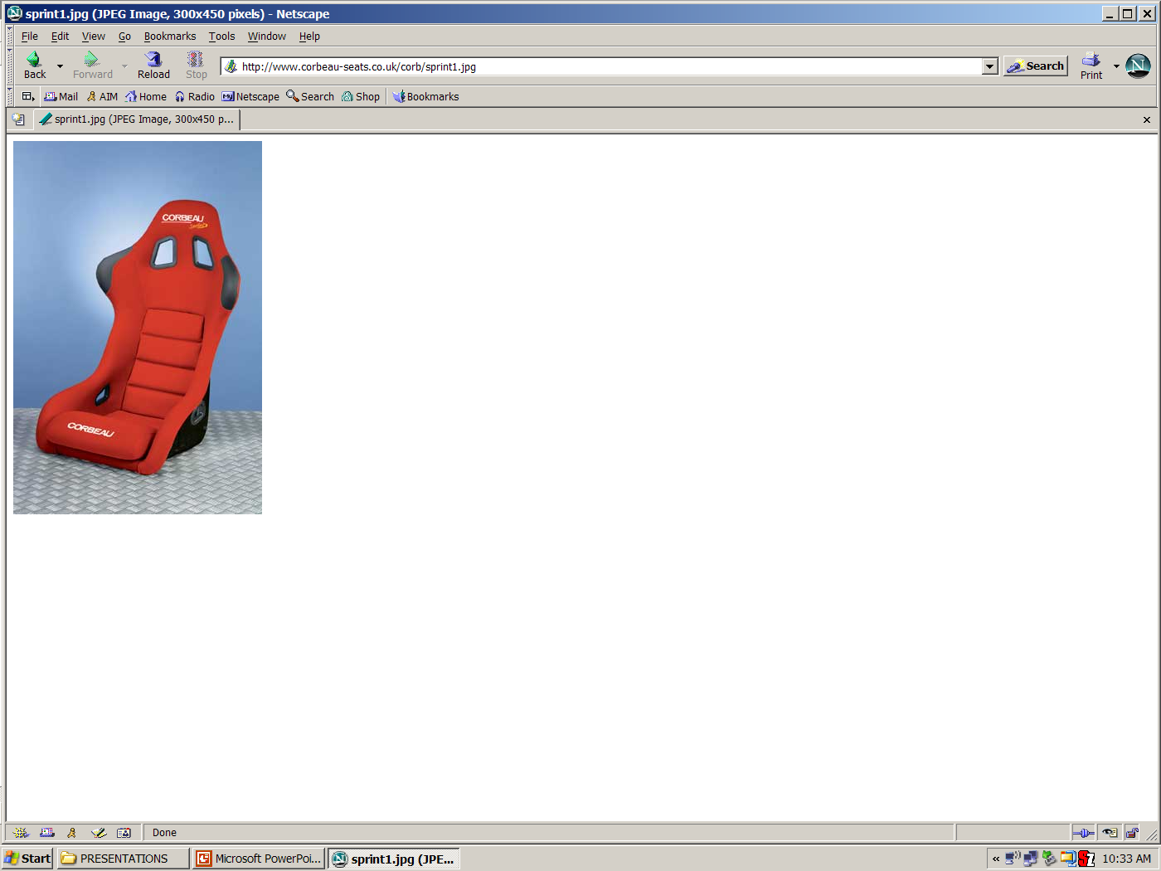
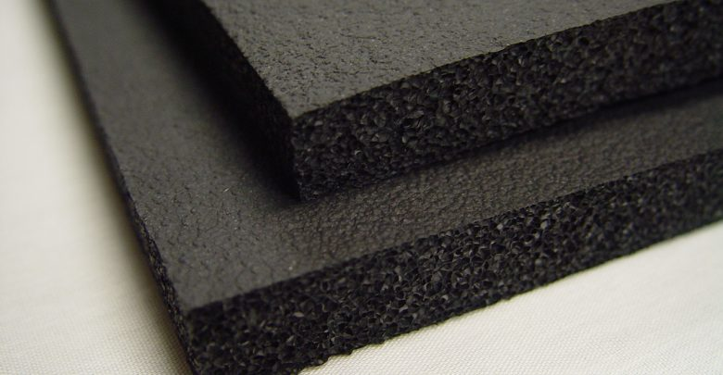
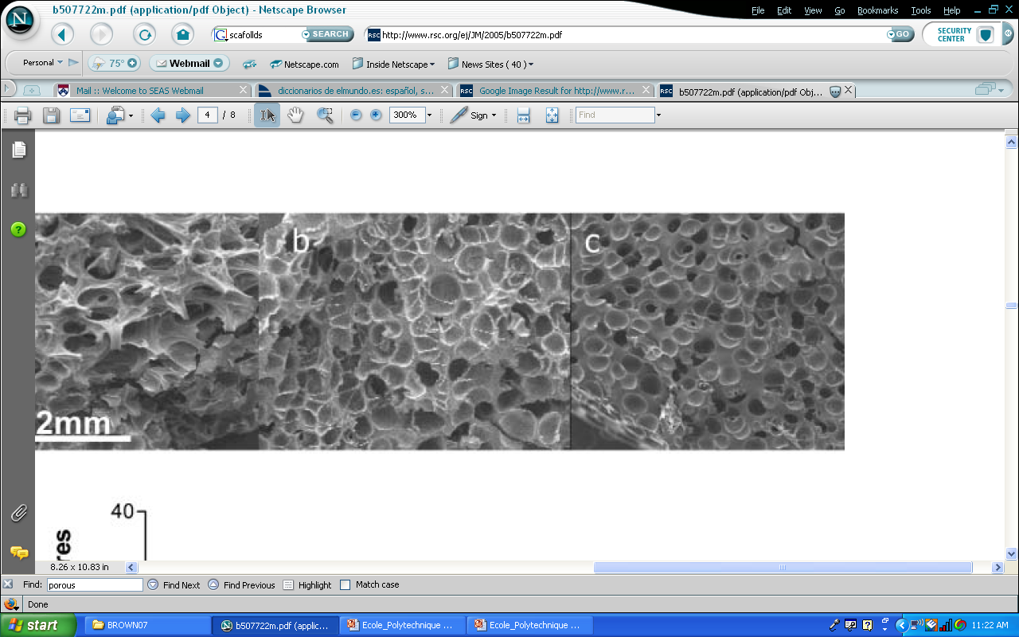

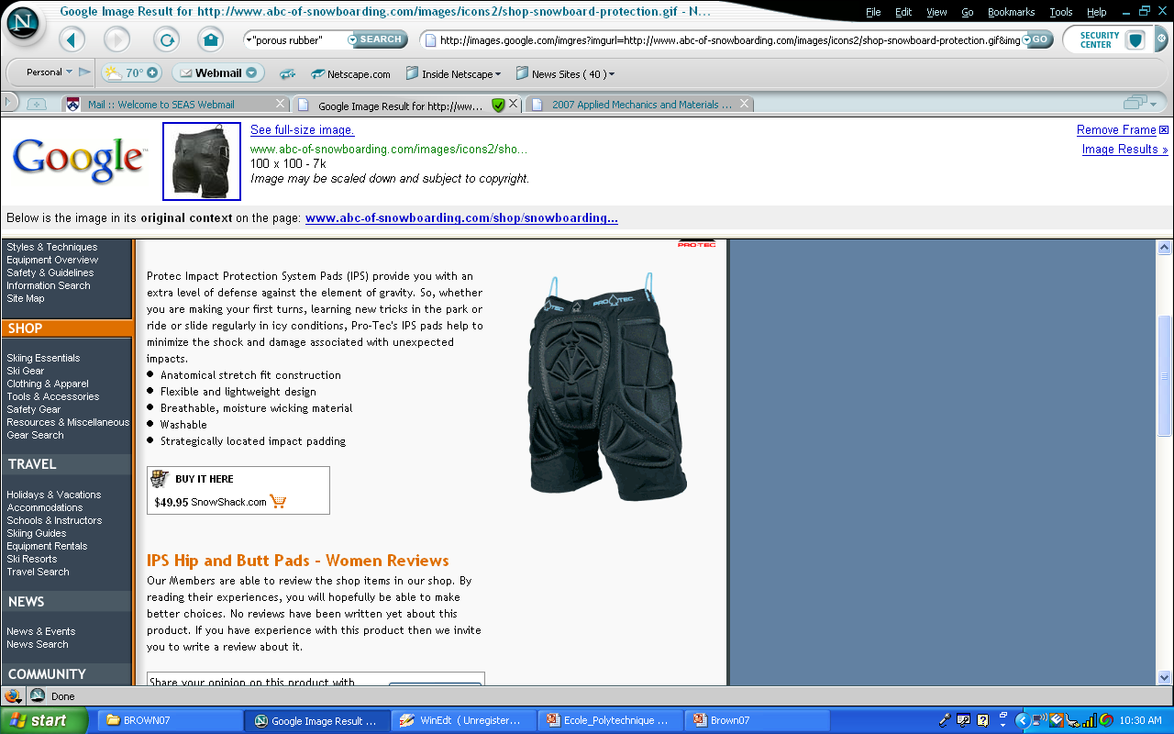
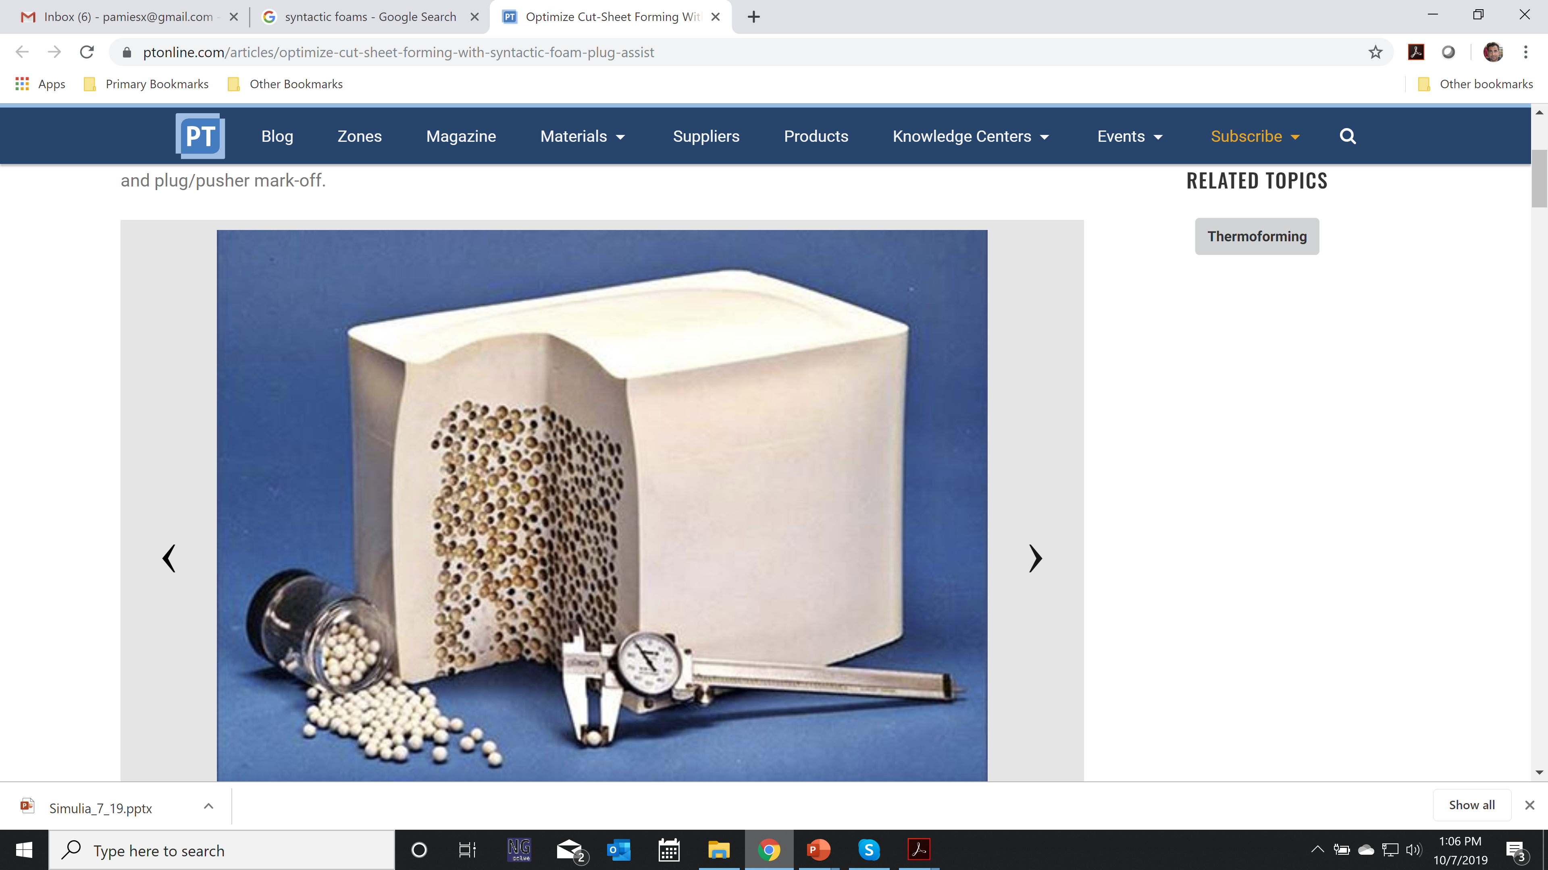


Notes:
()
Porous elastomers ubiquitously used in industry\\ (packaging material, rubber bearings etc.)
Lack of homogenization solutions that describe\\ the macroscopic response at finite deformations

Slide 3
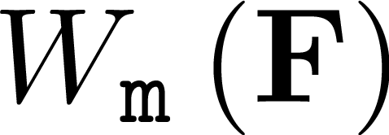
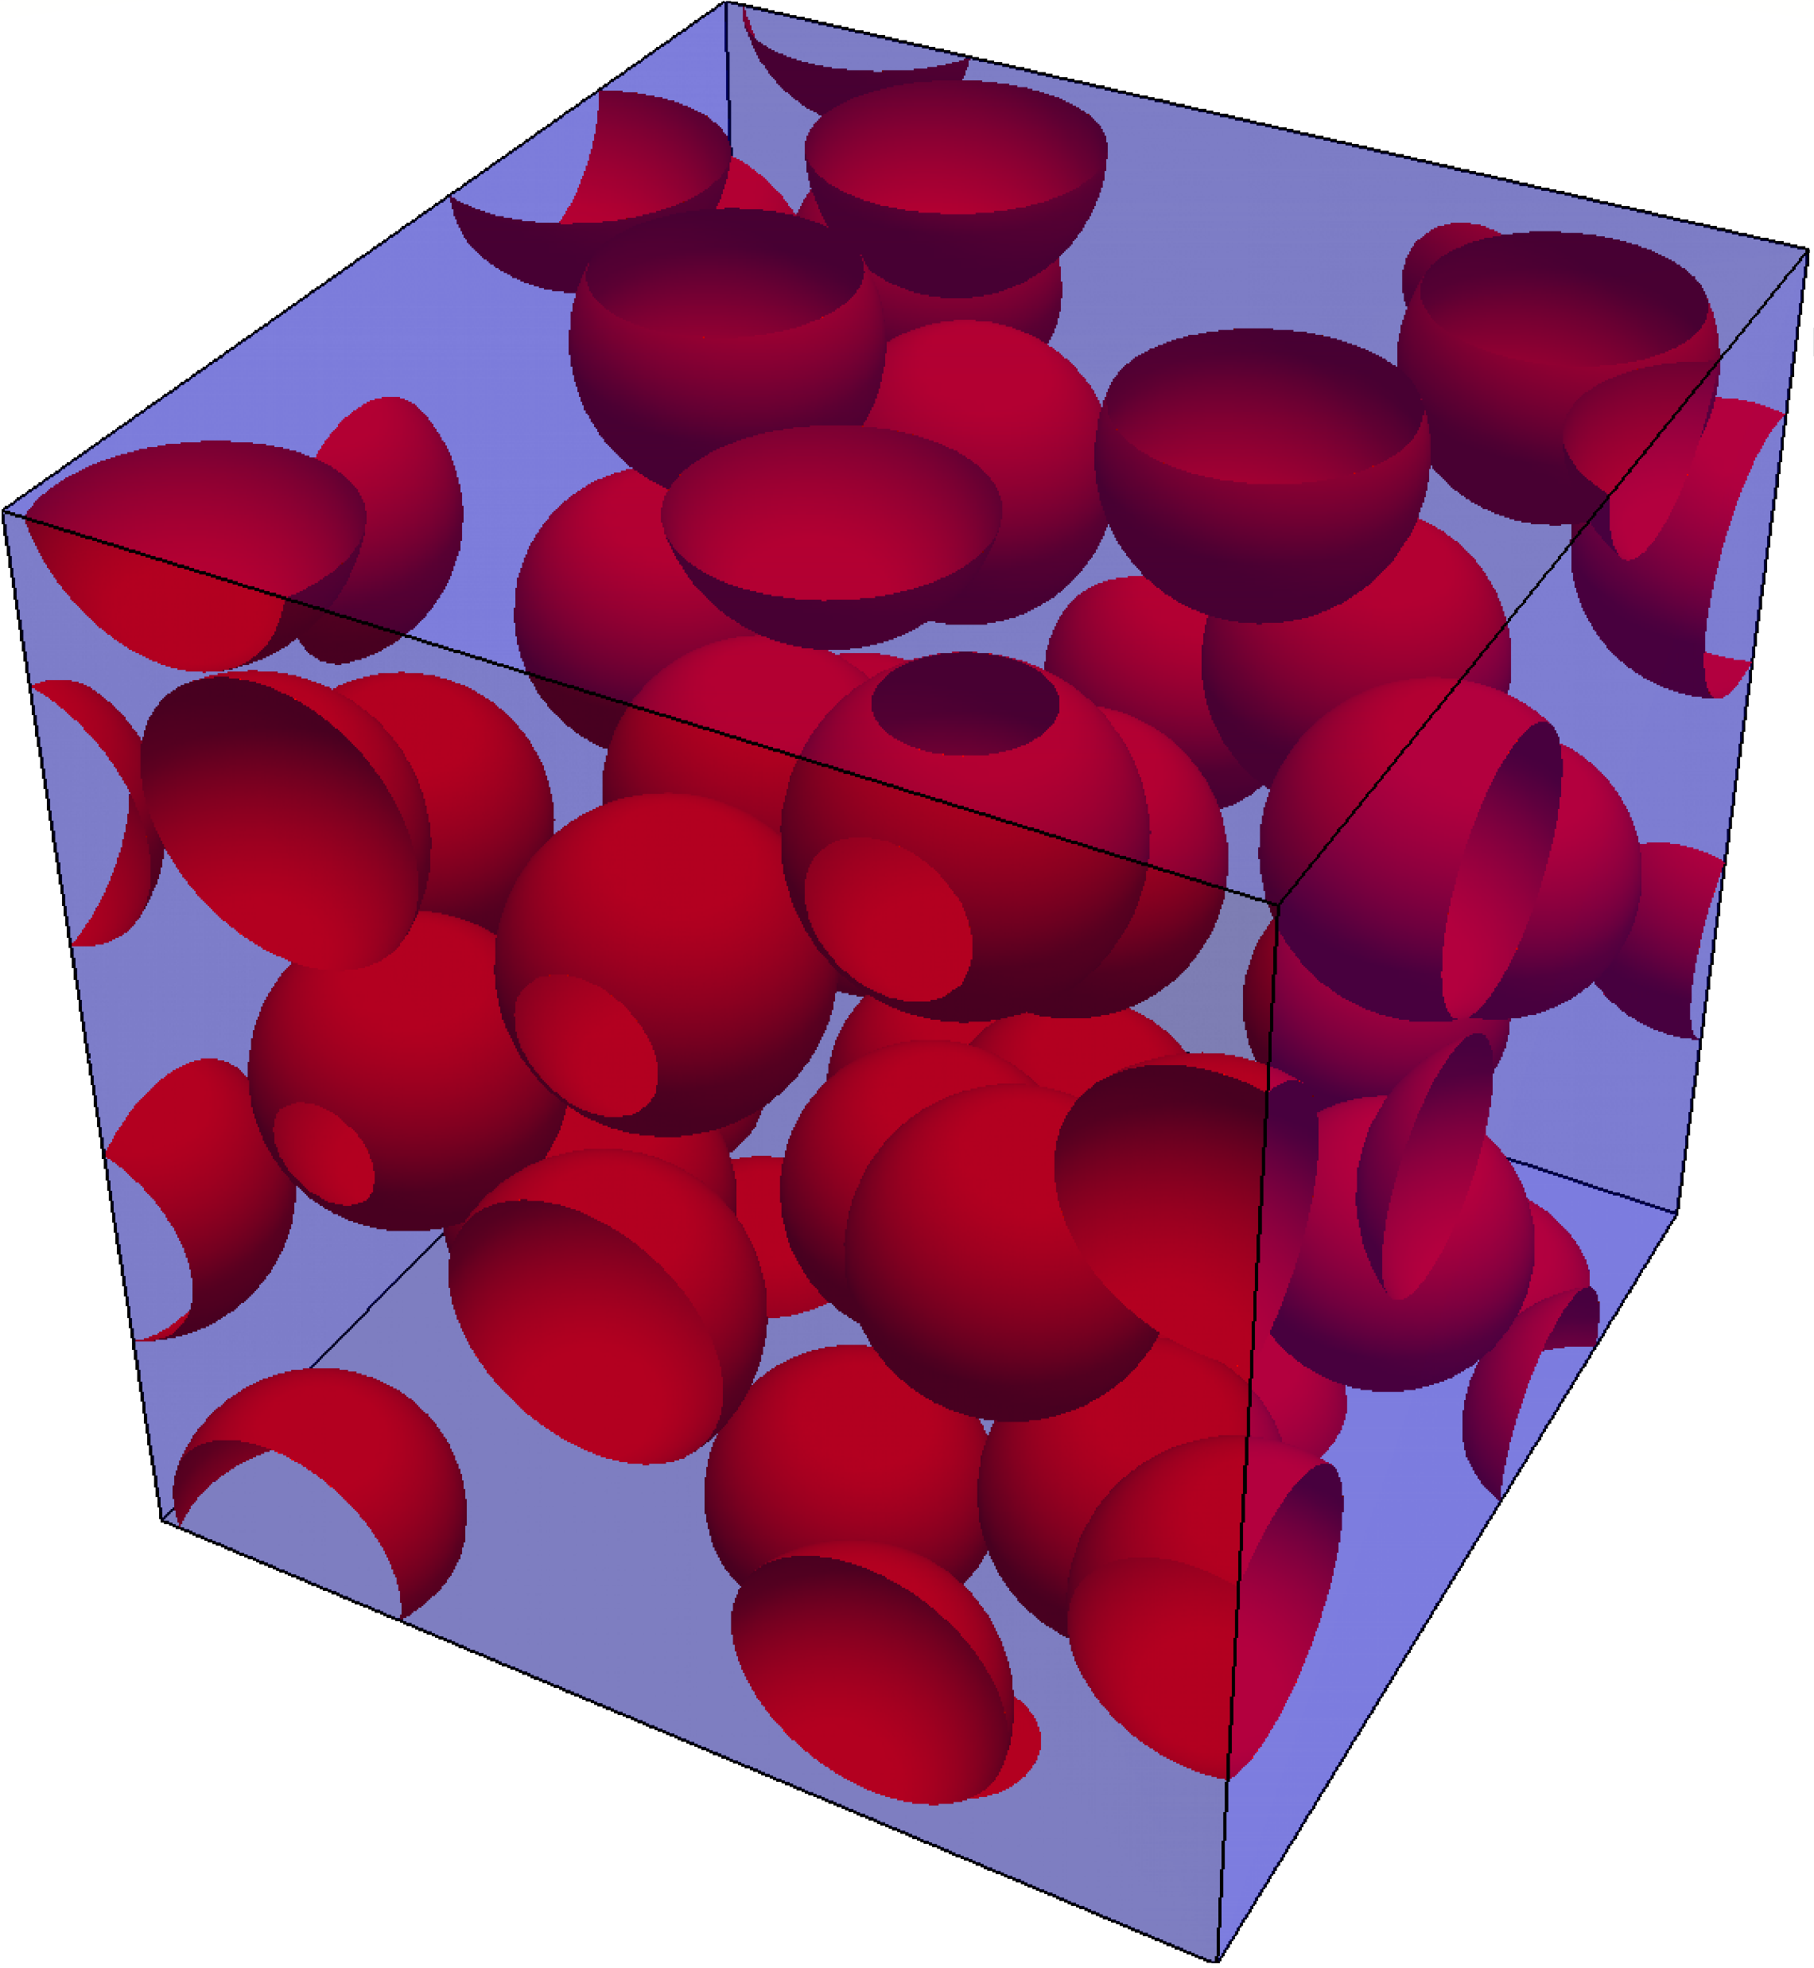
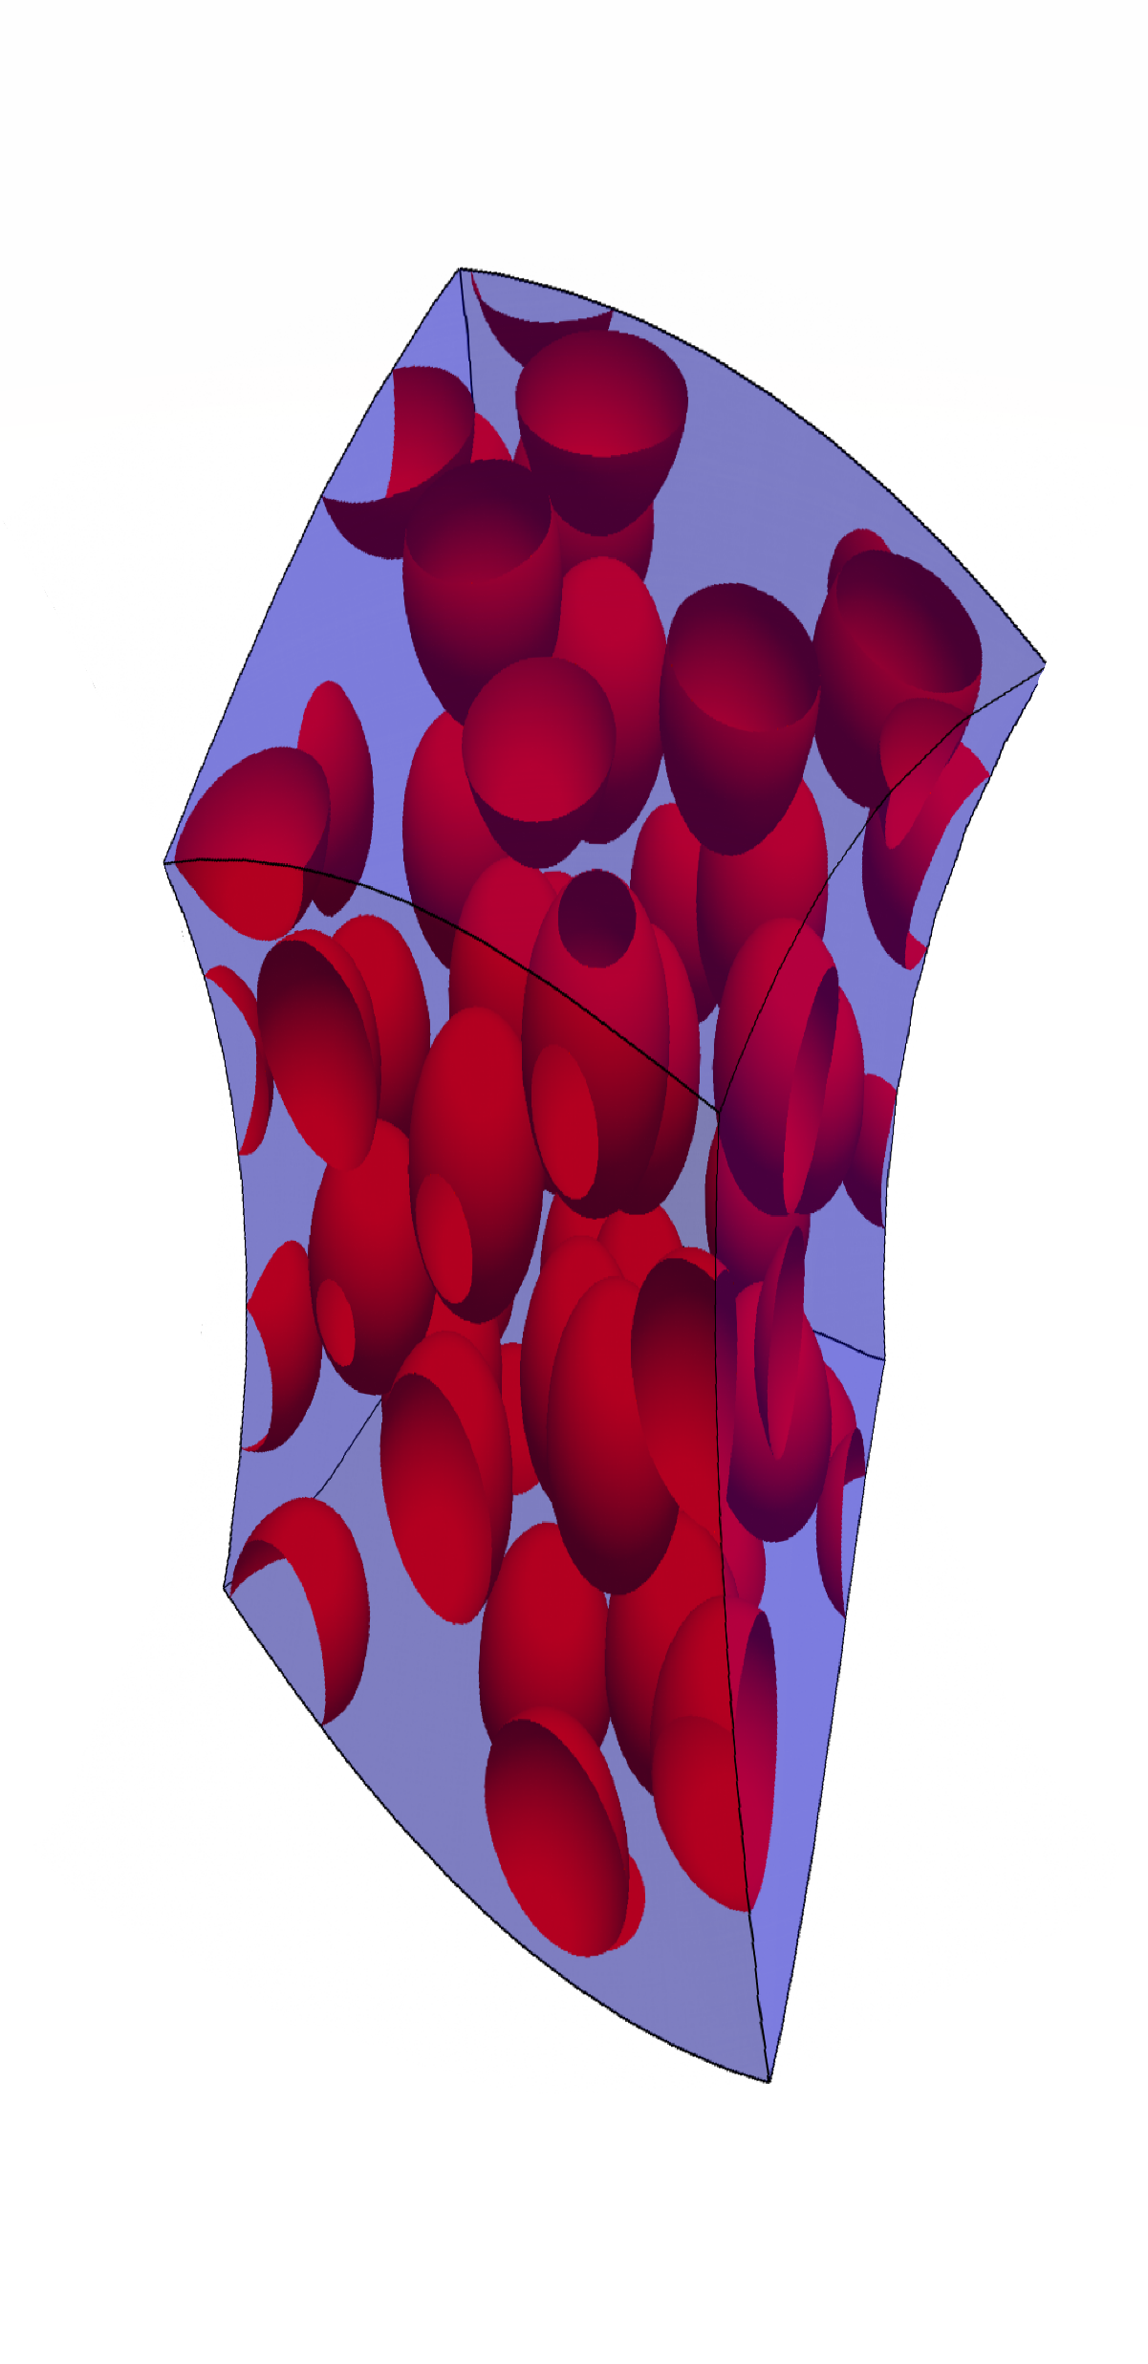
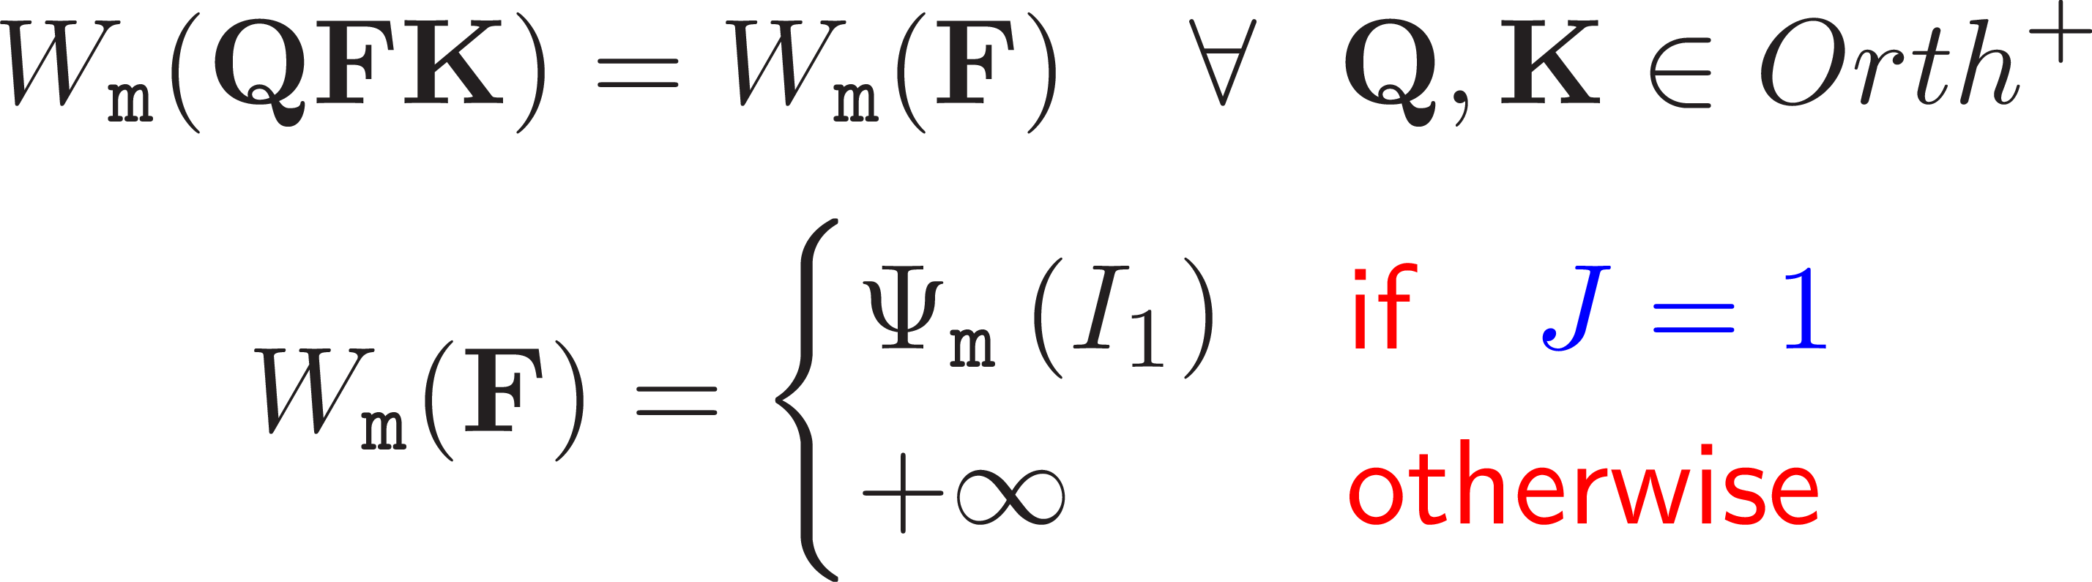
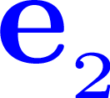
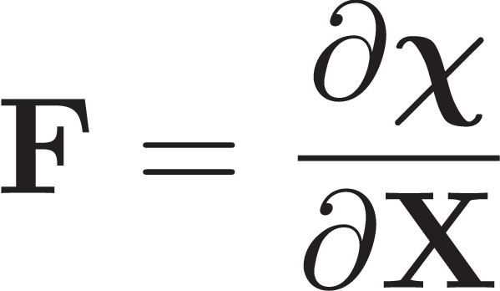
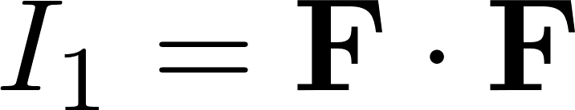
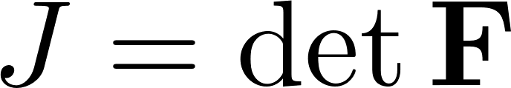


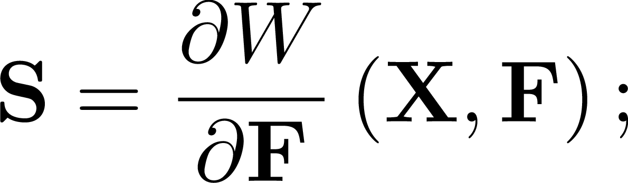
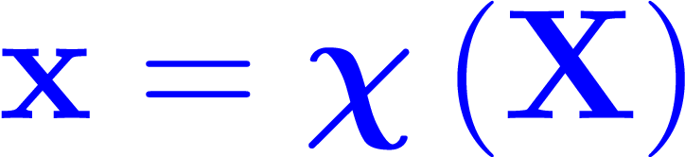

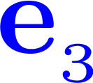
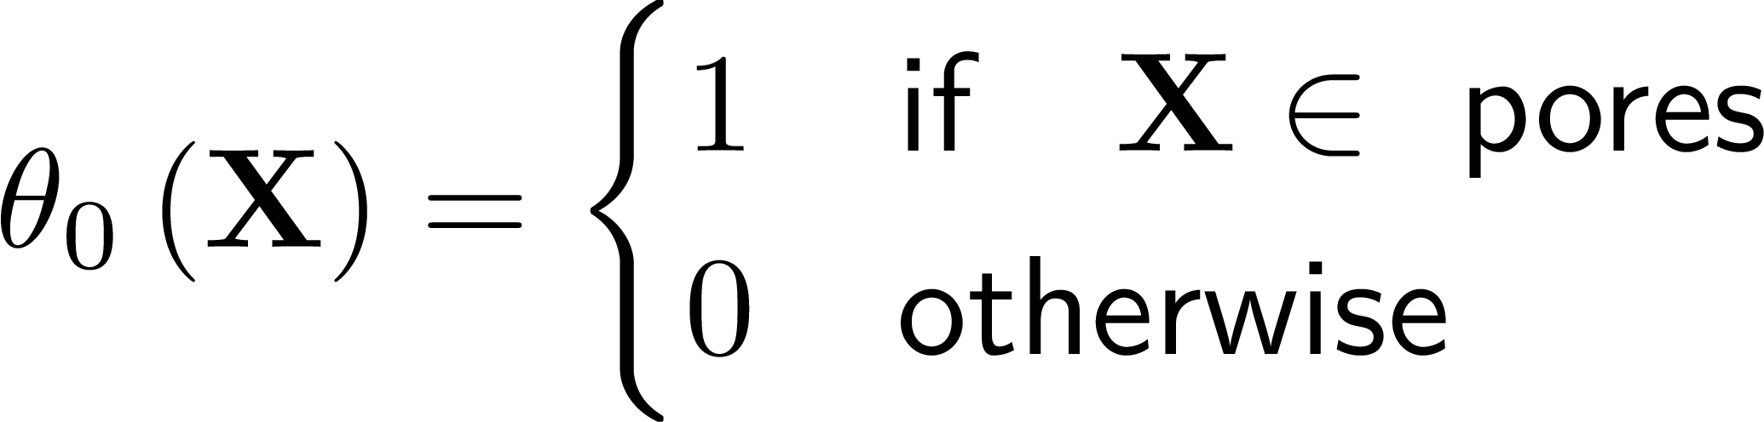
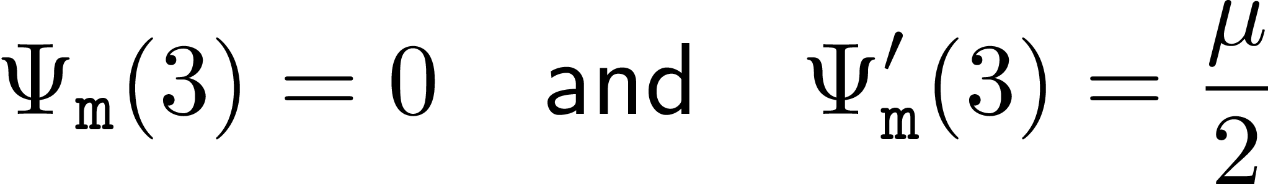
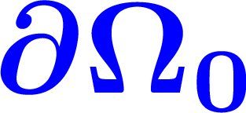
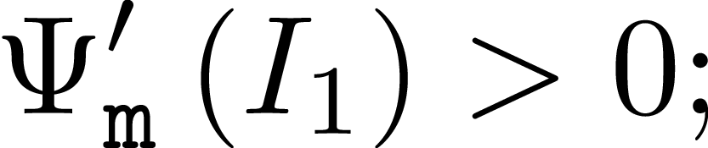
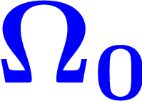
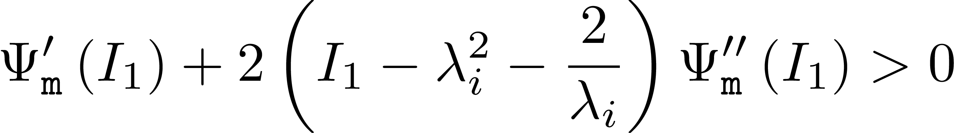
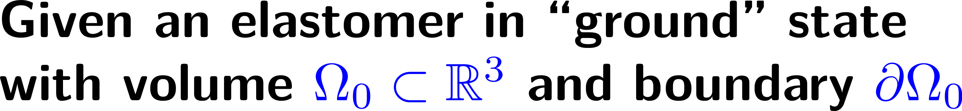
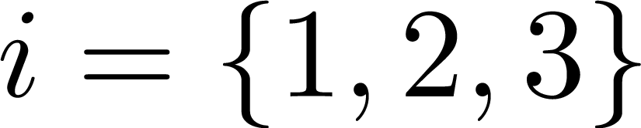
Notes:
Description of the Microscopic Kinematics: Not more than 1 min
-- ground state: stress free and undeformed
-- Deformation gradient
-- pointwise incompressibility
Upper bound: 1min: 20 sec
our focus in this work is on isotropic porous elastomers
Specifically those that comprise a statistically uniform and isotropic distribution of equiaxed --- but of arbitrary shape otherwise --- closed-cell vacuous pores embedded in an isotropic incompressible non-Gaussian elastomeric matrix.
In its ground state, presumed to be undeformed and free of stress, the bounded domain in $\mathbb{R}^3$ occupied by any such porous elastomer is denoted by $\Omega_0$ and its boundary by $\partial \Omega_0
and, for convenience, units of length are chosen so that $\Omega_0$ has unit volume. The constitutive behavior of the underlying elastomeric matrix is characterized by a free-energy density $W_\texttt{m}$, which is taken to be an objective and isotropic function
of the deformation gradient tensor $\bfF$. In particular, we shall consider non-Gaussian free- or stored-energy functions of the form

Slide 4
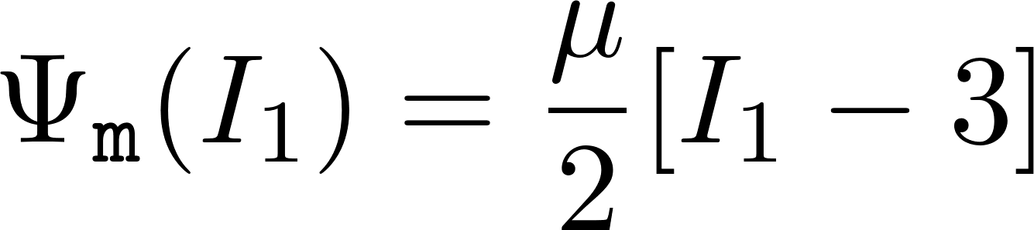
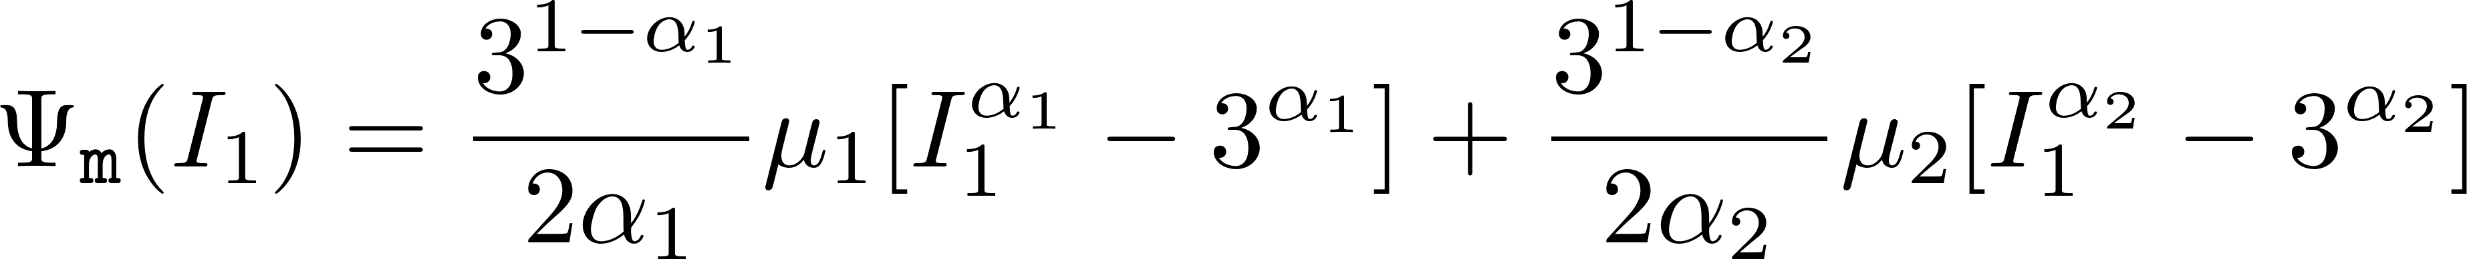
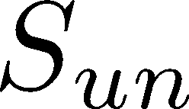


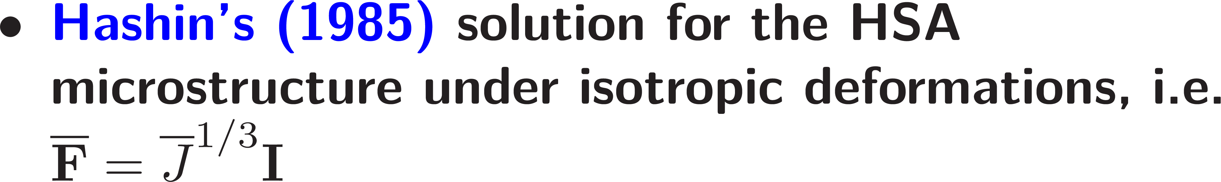
Notes:
30 sec
Many popular choices for the matrix material. Among these are Gent, AB, LP
Examples of typically used stored energy functions: LP (strain hardening, simple, accurate)
Upper bound: 1min:50sec

Slide 5
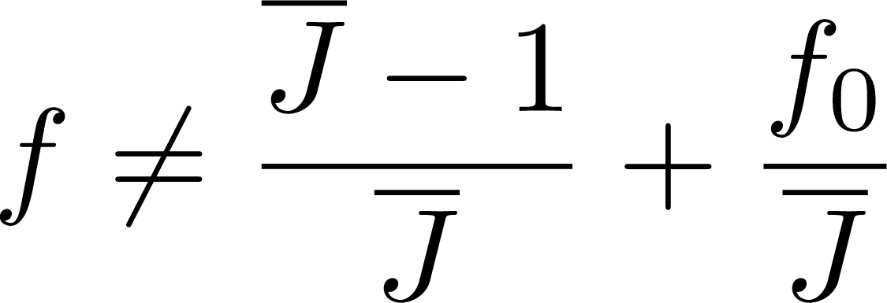
Notes:
The LP-PC result (2007) and LP (2011) is not explicit:
-- it requires the solution of 6 nonlinear algebraic equations
-- does not recover the exact evolution of the porosity

Slide 6
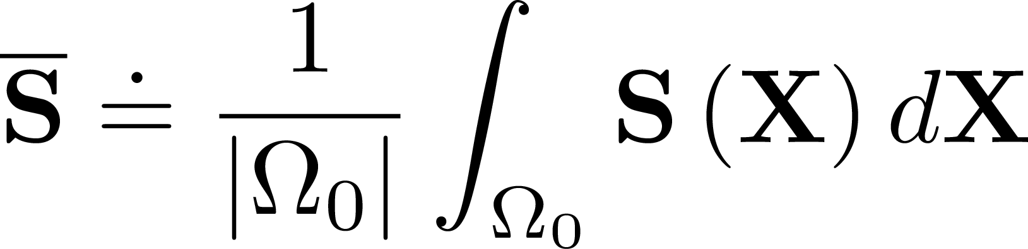
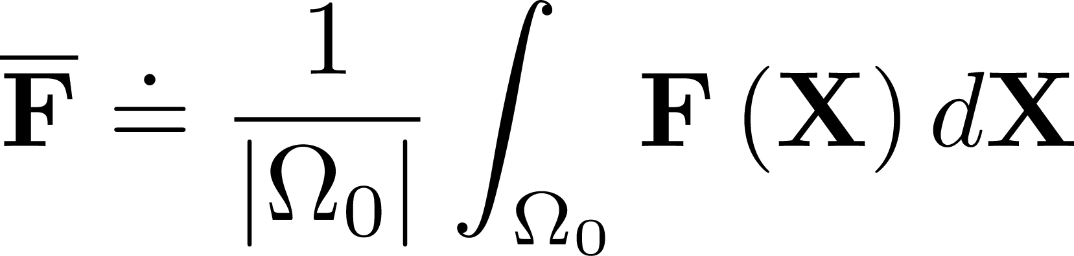
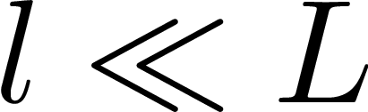
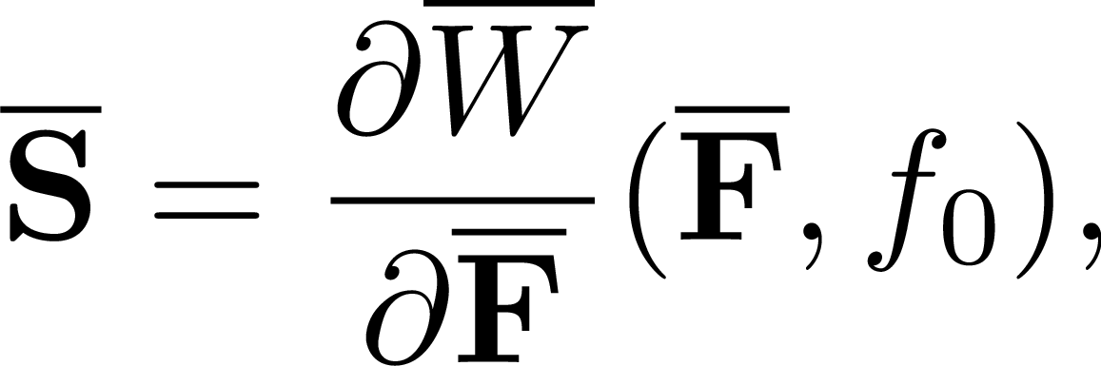
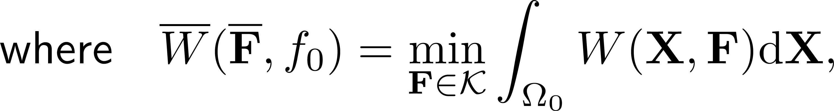
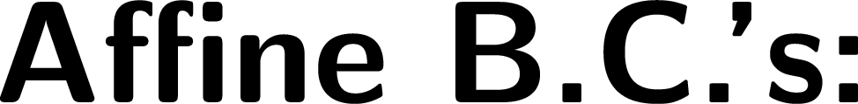
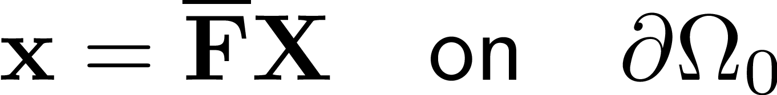
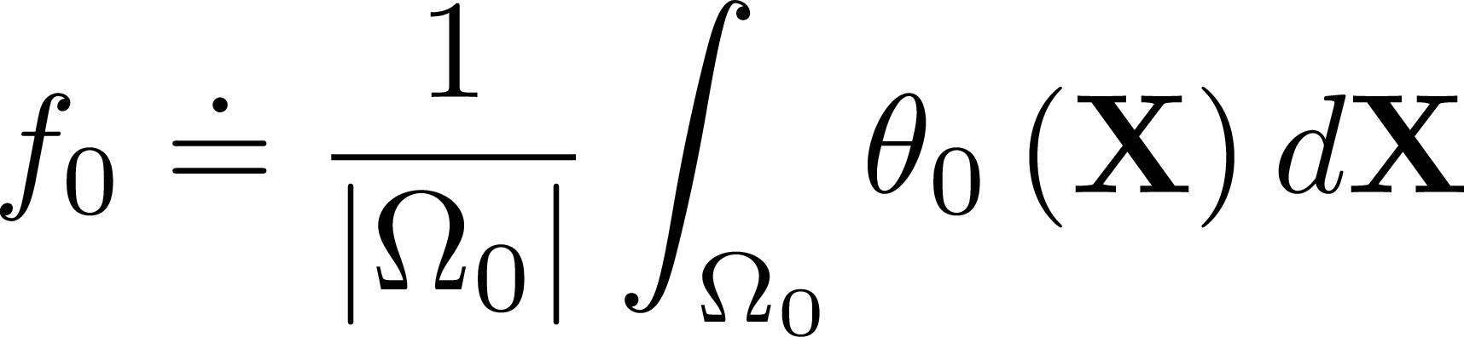
Notes:
To set things in place: (granted the separation of length scales)
- what we are after..
- Hill’s lemma and the variational form
- Weff is an isotropic function of the first argument. And hence the standard macroscopic invariants
1min (total)
Upper bound: 2min:50sec
%%
Granted the statistically uniform distribution of the pores and their vanishingly small length scale with respect to the macroscopic length
scale of , the homogenized or macroscopic constitutive response of a given porous elastomer of interest is formally defined as the relation between the volume average of the first Piola-Kirchhoff stress and the volume average of the deformation gradient under affine boundary conditions on. It follows from standard arguments that such a relation can be expediently cast in the variational form
%%

Slide 7

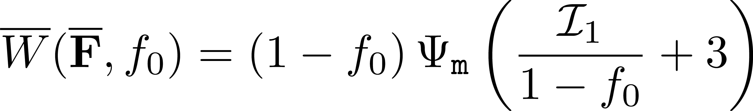
Notes:
Describe the main result:
-- the matrix material (stored energy function evaluated at an amplified measure of strain)
-- the linearity in I_1 and nonlinearity in J (and of the variable separable form)
30 sec:
3min: 20sec:

Slide 8

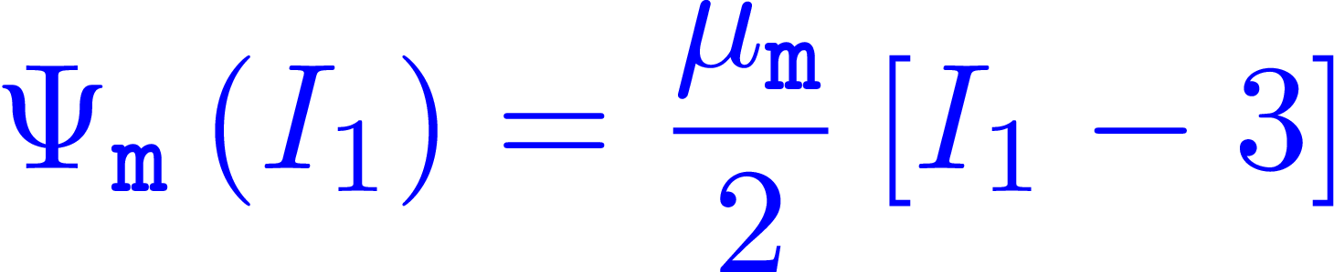
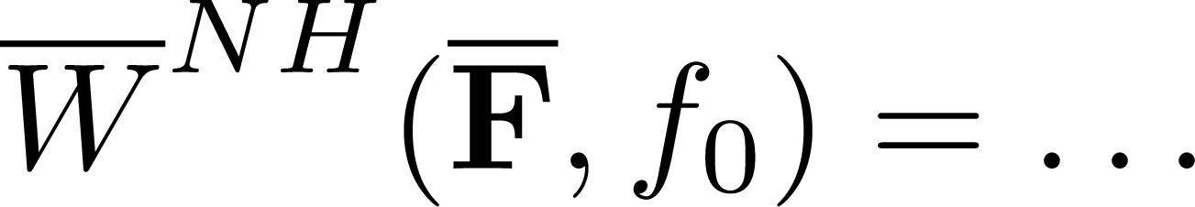
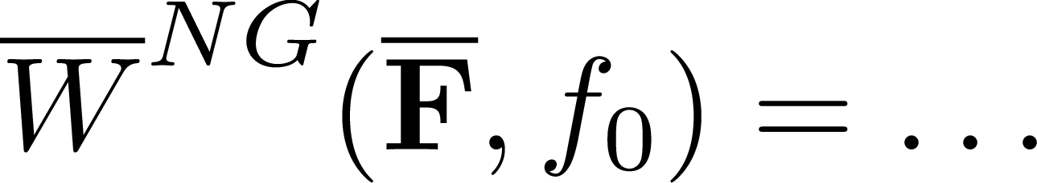
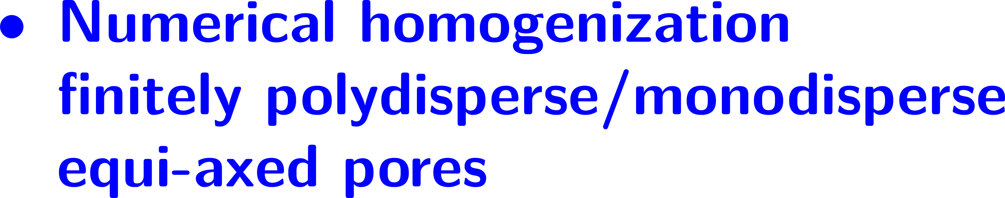
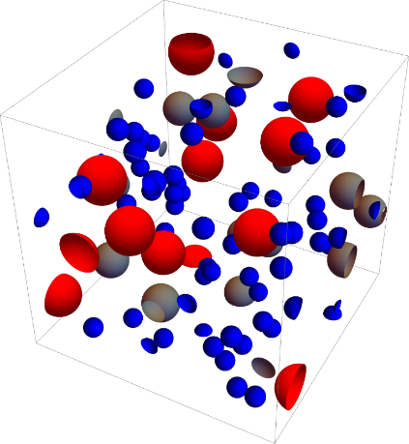
Notes:
** Add references for Ogden, and Hashin’s paper
Quick walk through: 30 sec:
Rough outline (not more than a min)
Upper bound: 3min: 50 sec

Slide 9
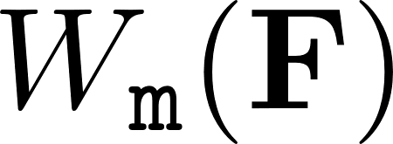
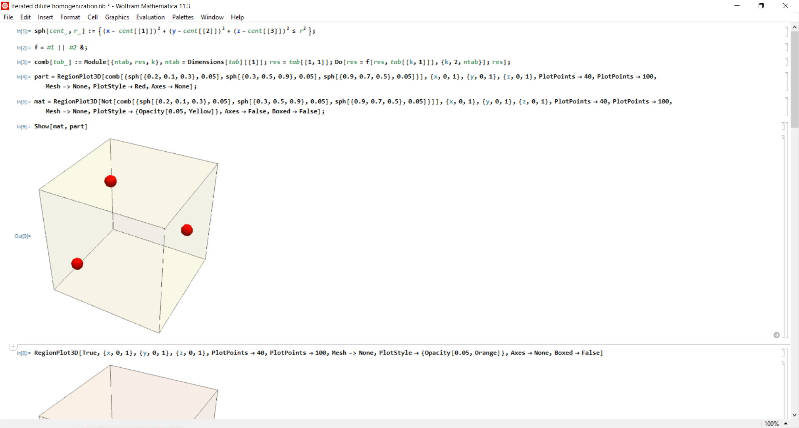
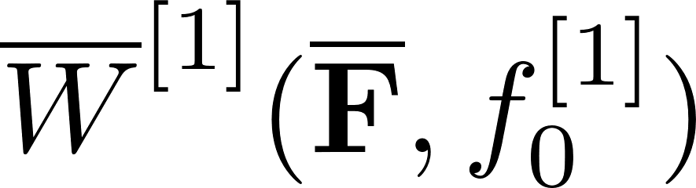
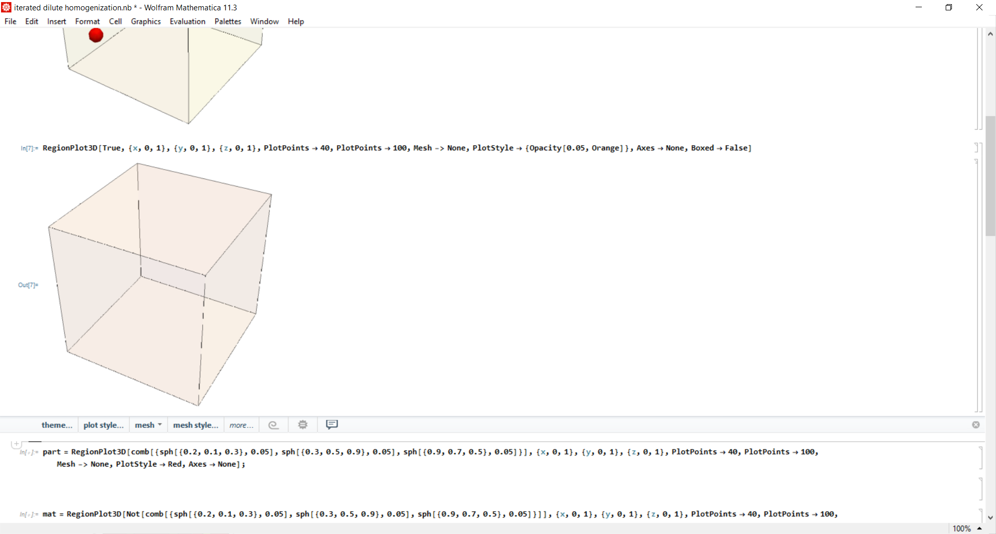
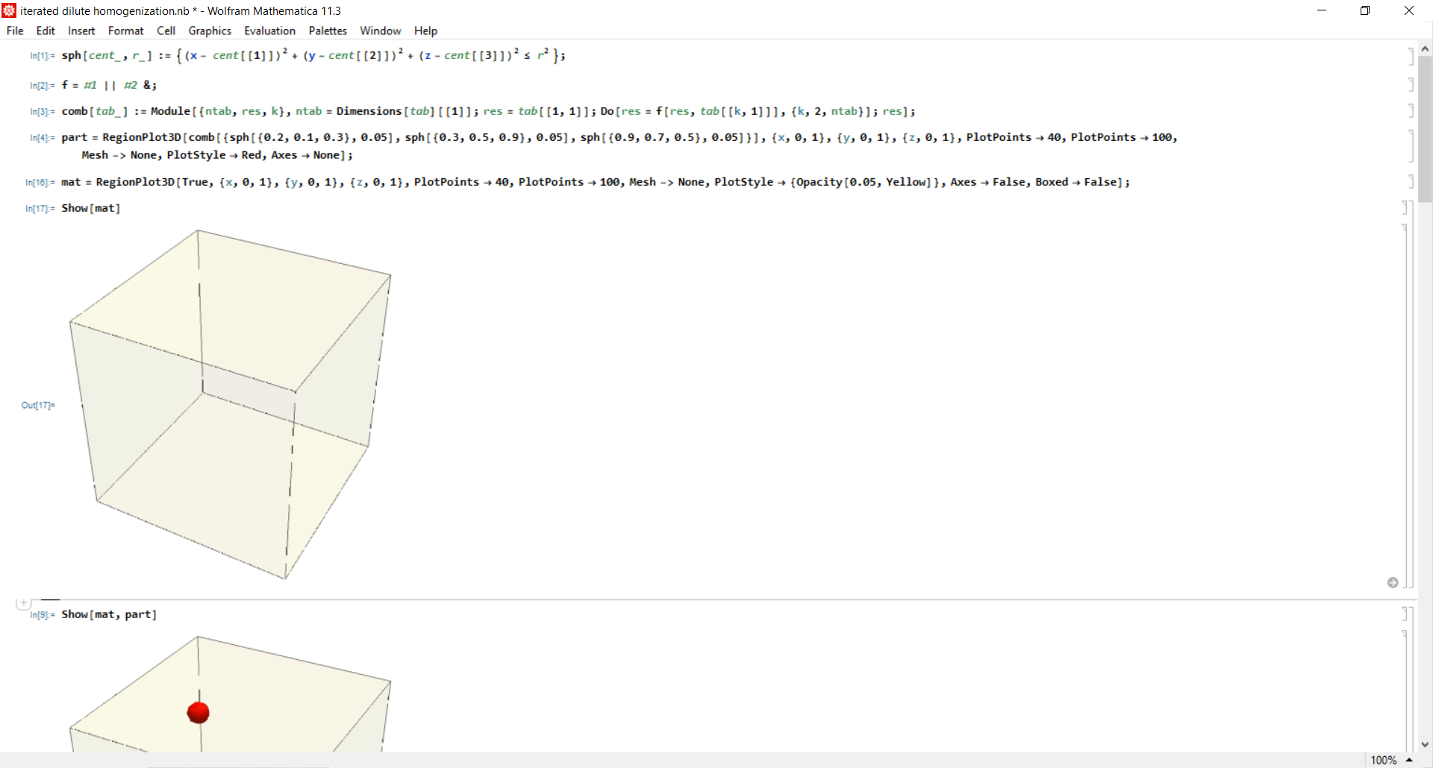
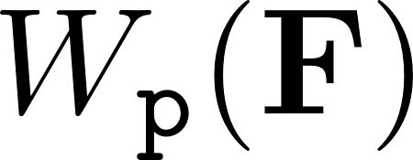


Notes:
Iterated Homogenization: LP and MI, allows to construct analytical solution
-- start with matrix and add a dilute concentration of particles with W_m (potentially pores; = 0)
-- keep repeating the process over again.
15 sec
UB: 4min:05sec

Slide 10






Slide 11




Notes:
By passing to the limit one obtains the HJE, an initial value problem for Weff
-- one could do the same process, but by beginning with pores (or W_p more generally)
and then adding dilute fractions of the matrix.. Proves to be a better choice
But, all of this rests on the knowledge of the Hamiltonian H
40 sec:
UB: 4min:45sec

Slide 12






Notes:
Are there microstructures where the analytical Hamiltonian is known.
-- coated laminates. Keep laminating along directions.
-- is the lamination sequence important ? Well, for one of the dilute limits.

Slide 13








Slide 14






Slide 15



Notes:
P_o ^ ii is the two point correlation function.
In general no closed form expression, but for an “isotorpic” distribution of pores, it takes a value of1/4/pi
Upper Bound: 5min: 30 sec

Slide 16






Notes:
Now putting everything together, we have all the tools needed to state the problem we seek the solution to.. (at this point you should not have crossed the 5.5 min mark…. )

Slide 17







Notes:
WENO solutions.. Key features….
-- the porosity `f` is the pseudo-”time”-like variable.
-- the components of the deformation gradient play the role of space. (skip)
-- fifth order accurate: later in the talk explicitly show the fifth order convergence in the 1-norm of the relative error.
--

Slide 18


















Notes:
Comparison with the analytical estimates for the 2D problem

Slide 19








Notes:
Now the comparisons of WENO with the approximations:

Slide 20






Slide 21





Slide 22



Notes:
Small deformation limit: Approximation vs the FE results

Slide 23







Notes:
Again linear in I_1 and independent of I2: and of the variable separable form W_I1 + W_j

Slide 24


Notes:
For the special case where the underlying elastomeric matrix is Neo-Hookean, you have the explicit formulation

Slide 25


Notes:
Linearization of the result recovers Hashin’s result. Also the asymptotic behaviour in arbitrarily large deformations

Slide 26






Notes:
Commend on the agreement

Slide 27








Slide 28







Notes:
All the results for NeoHookean done.

Slide 29




Slide 30


Slide 31






Slide 32


Slide 33



Slide 34



